Slide 1


Passion
n

Slide 2



Slide 3


Slide 4


Slide 6
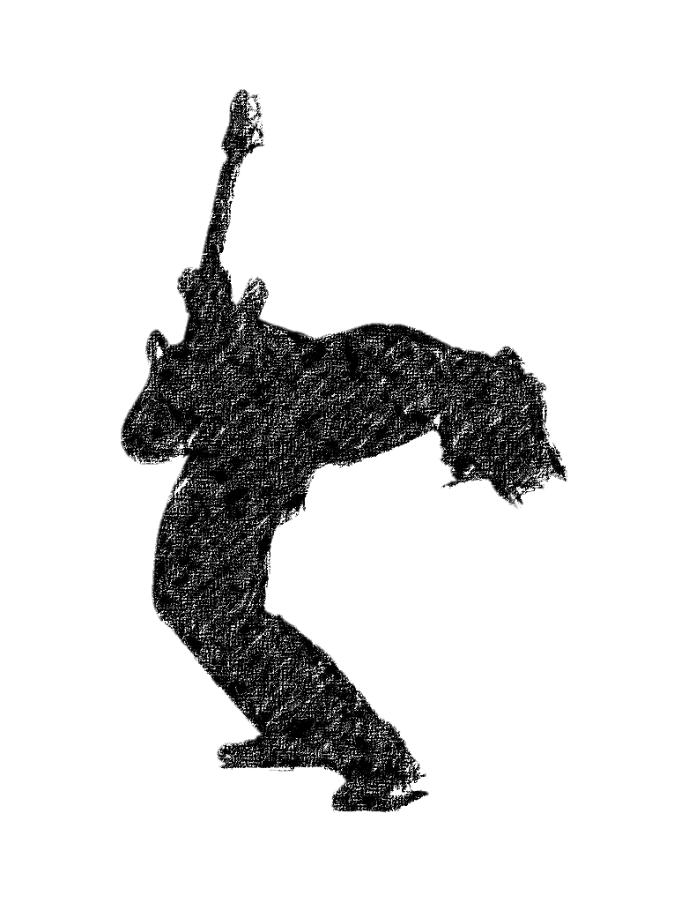

Slide 7
Mus c
Music
Music

Slide 8
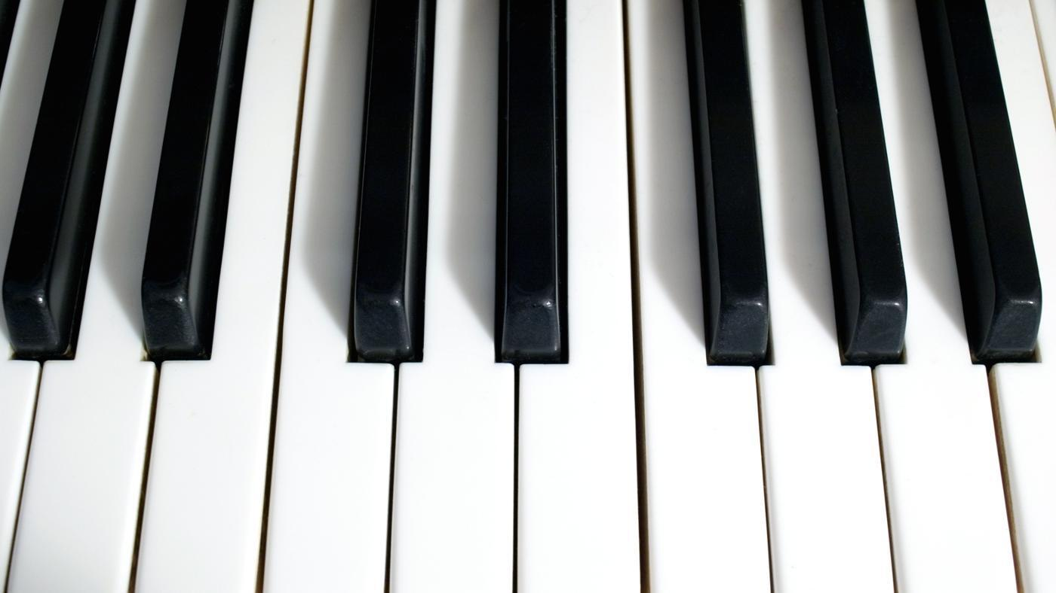
Classic

Slide 9


Slide 10





Starting

Slide 11
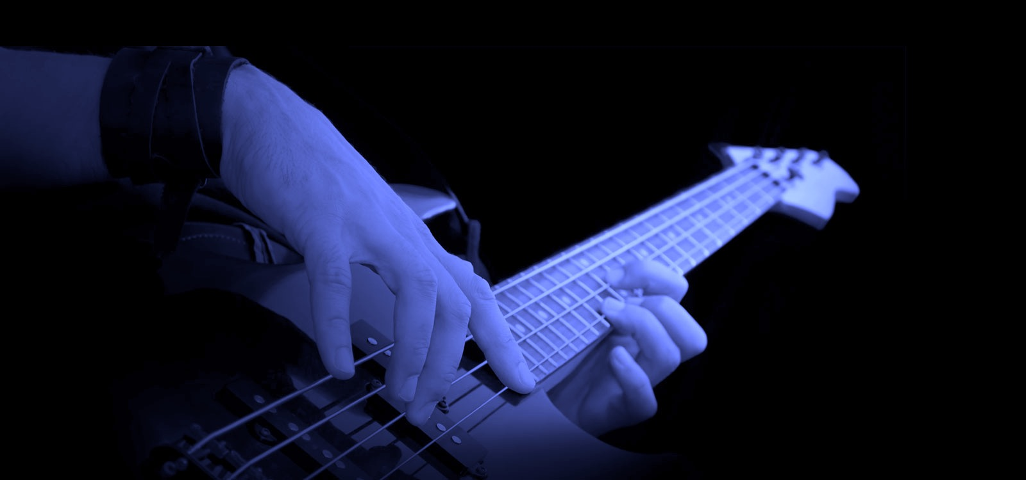
Musician

Slide 13
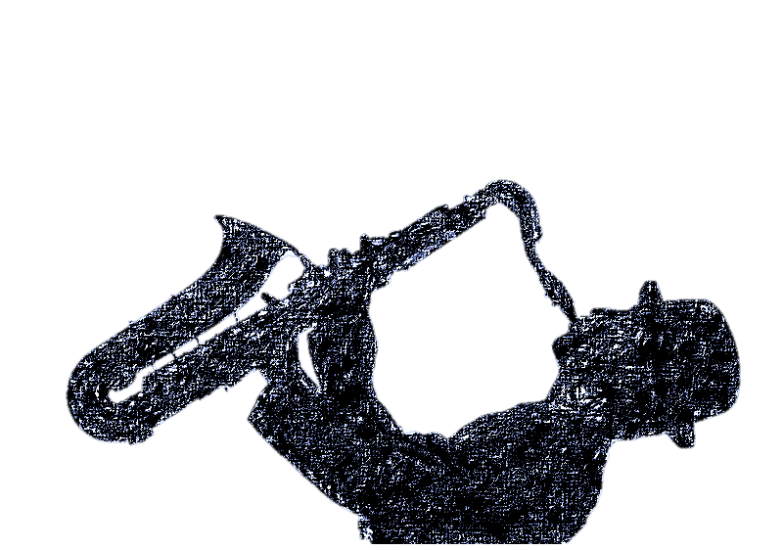
Starting

Slide 14
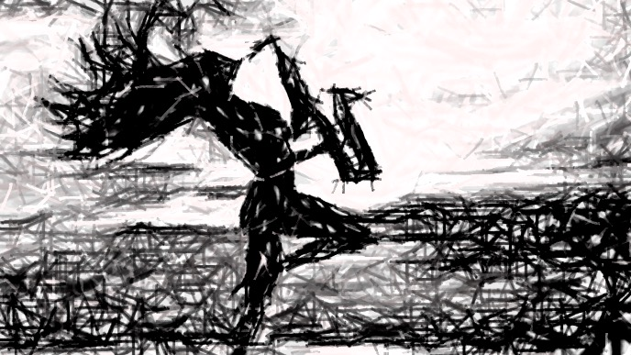

Slide 16
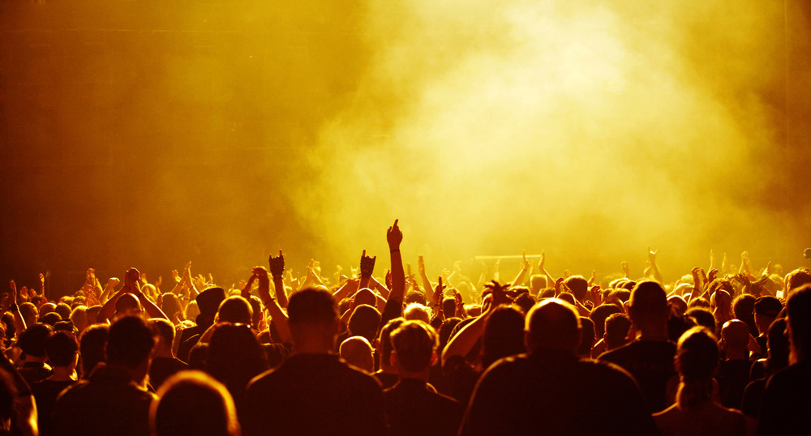
Passion
Passion

Slide 17
MUSIC

Slide 18
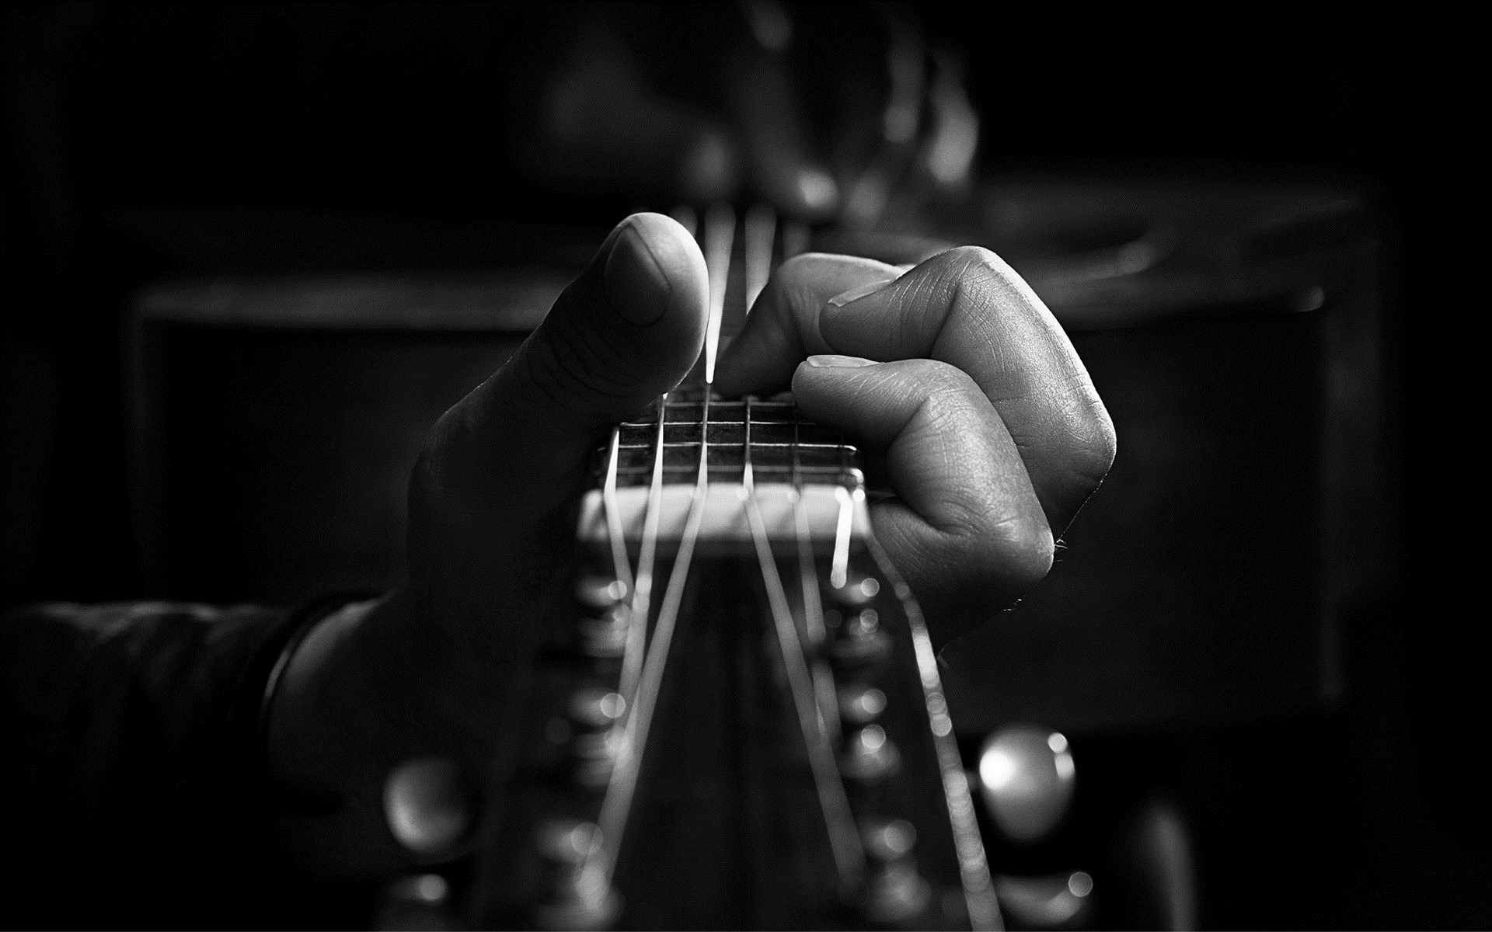

Slide 19
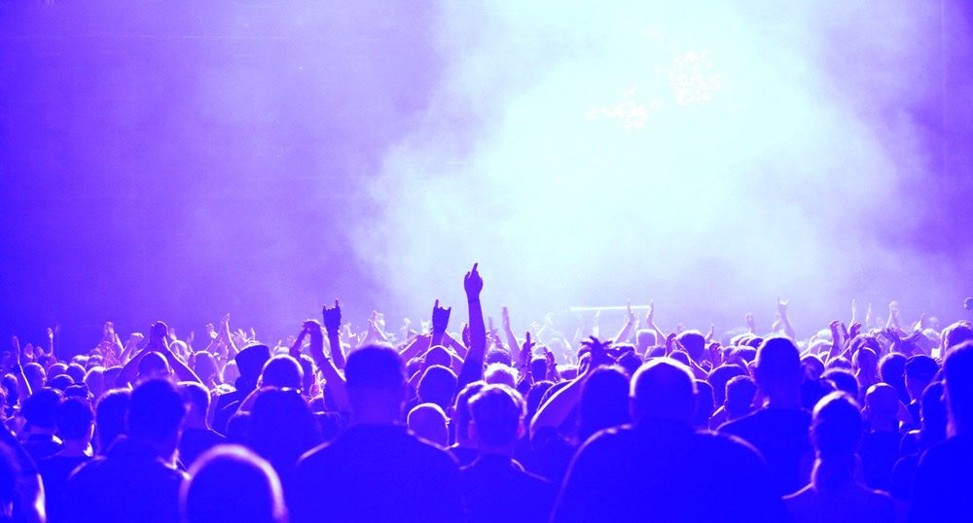

Slide 20


Slide 21
THAT IS THE SUBTITLE OF THE PAGE
Moment of music baby – gallary slideshow
Urbanity of music guitar+party picture -hover
Start of music – game
Classic of music – ballet, click ballet,
show all picture

Slide 22
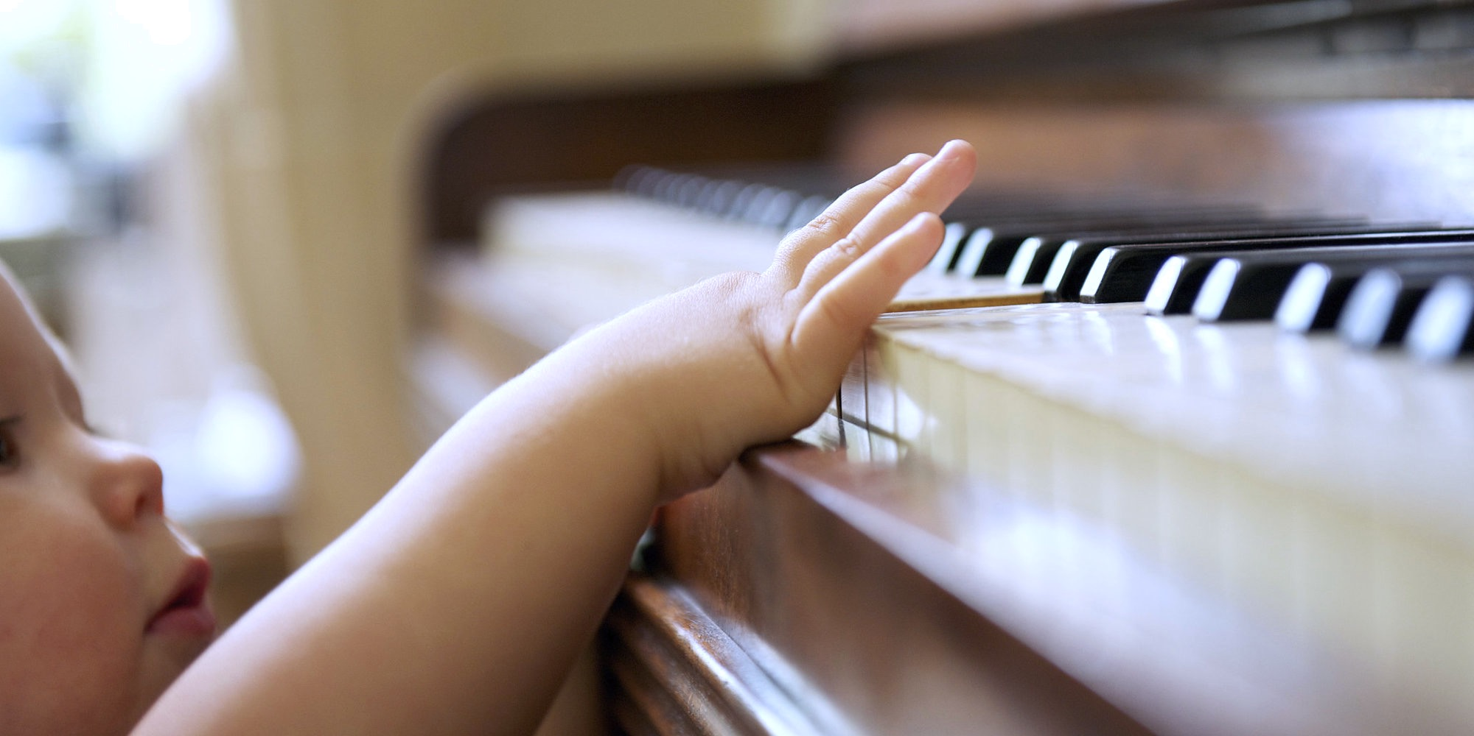

Slide 24
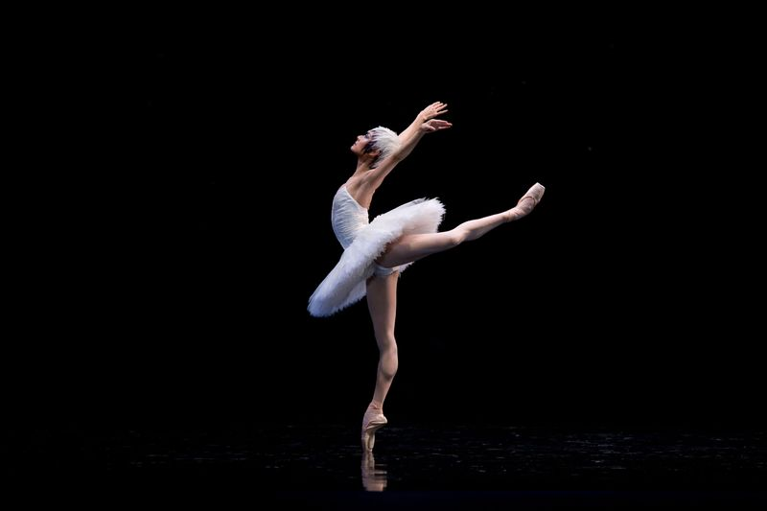
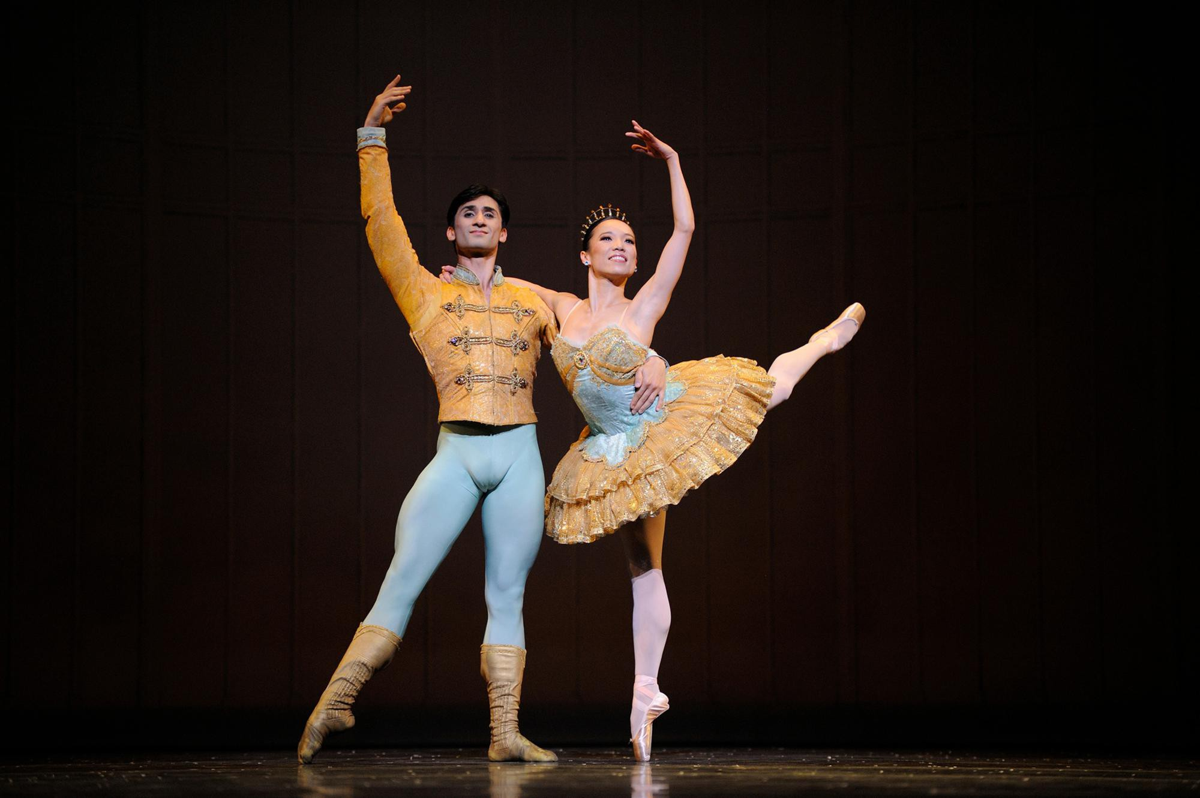
Moment of music baby
Urbanity of music
Story of music
Classic of music

Slide 25
